Slide 1
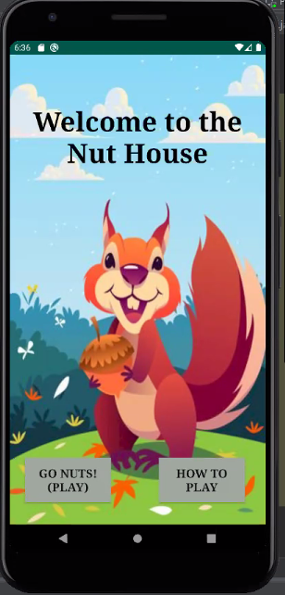
The Nut House
Brennen Nalley, Josiah Moore, Renee Lucas

Slide 2




App Overview
Squirrel Version “Snake”
Collect Acorns
Each Acorn 10 Points
Adds another Squirrel
Game Over:
Out of Bounds
Hit Another Squirrel in the Line
Images
Fair Use Squirrel Sprite
Acorn Aseprite
Fair Use Images for Home and Game Over Screens

Slide 3
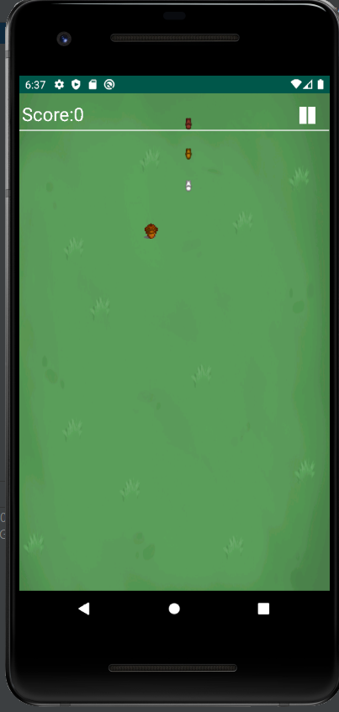
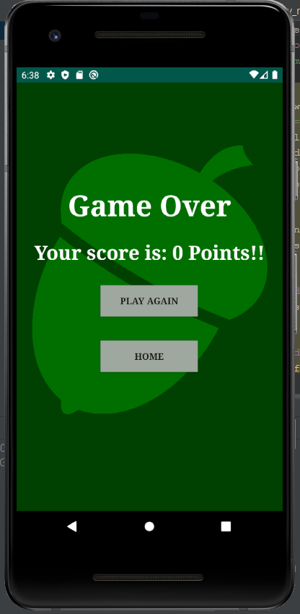
App Overview
Consist of Several Activities:
Main Menu
Play Game Instructions
Play
Game
Consists of a Canvas
Sprite Animation
Game Over Screen
Return to Main Menu
Play Again

